Slide 1
Spill N Fill Website
Changes / Corrections

Slide 2


Slide 3
Home Page
Increase size of Spill N Fill logo on left hand corner.
Correct the spelling of “Spill N Fill”
Make it “About Us”
Replace “Contact Us” at the bottom with “WhatsApp Icon”
Add the “ ” on each page just as done in V4U website.
The actual Glass Bottle should be completely visible on the Homepage.

Slide 4
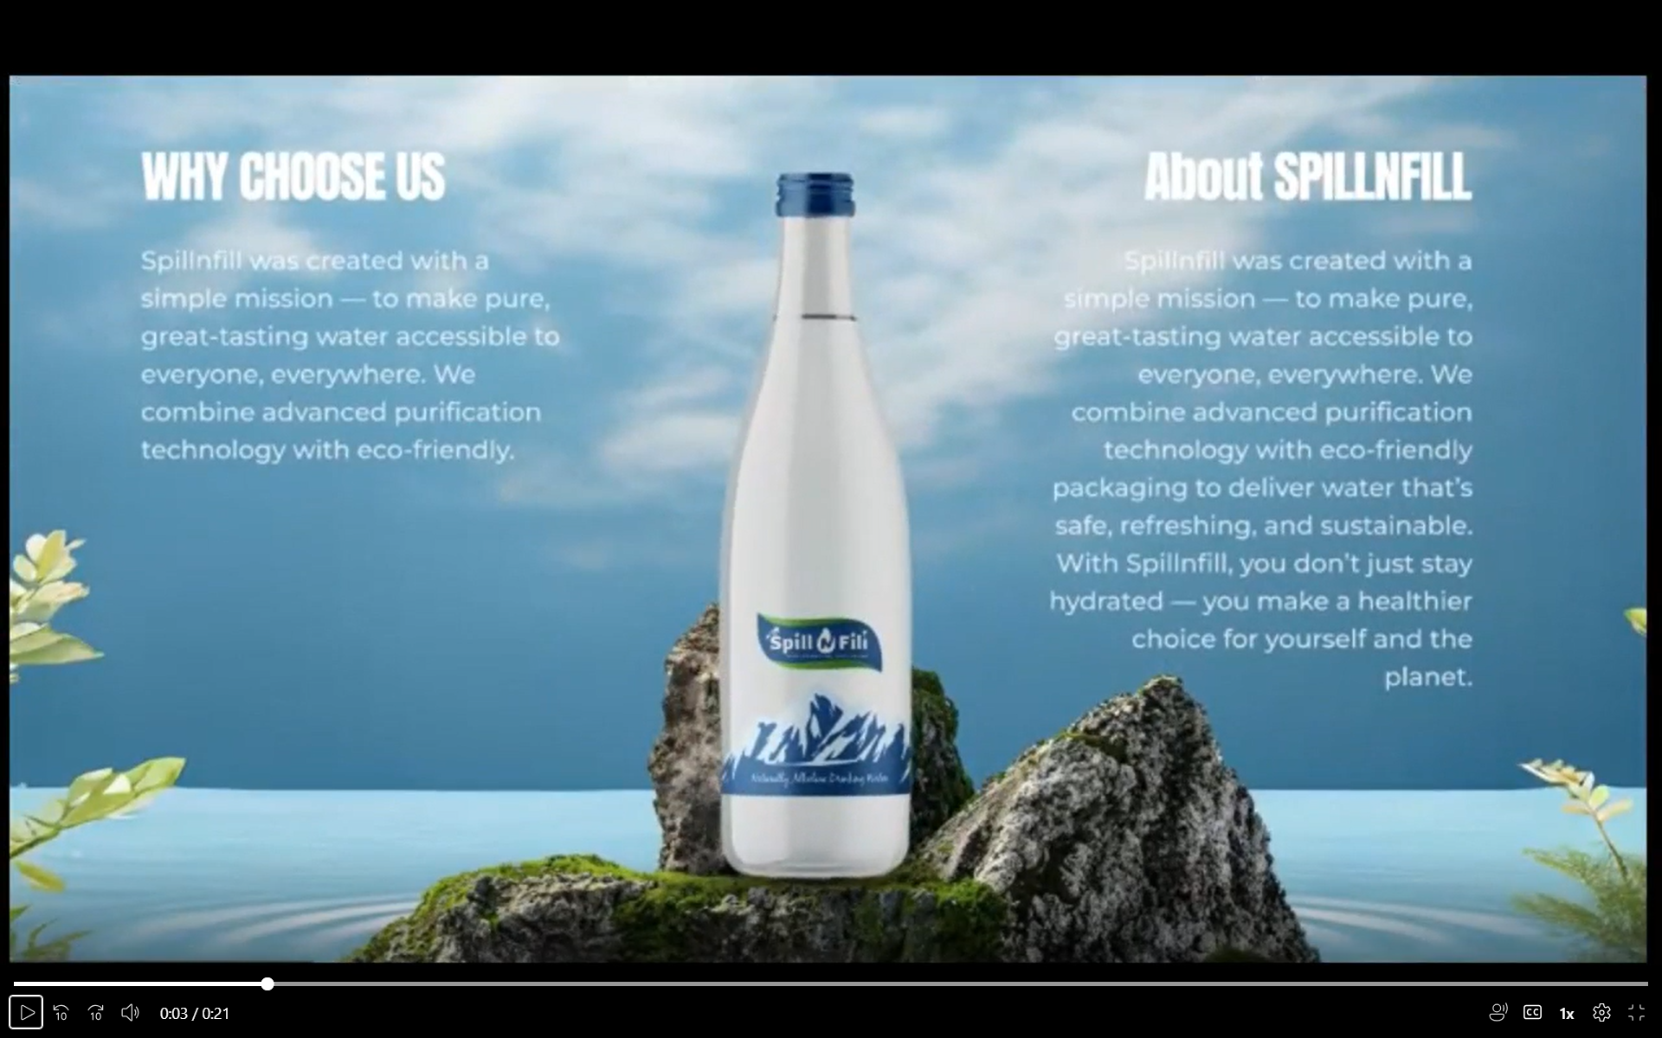

Slide 5
About Us
About Spill N Fill Spill N Fill was created with a simple mission — to make pure, great-tasting water accessible to everyone, everywhere.
We combine advanced purification technology with eco-friendly solutions to ensure every refill is safe, sustainable, and refreshing.
By reducing single-use plastic and promoting responsible hydration, we’re helping build a cleaner, greener future — one refill at a time.

Slide 6
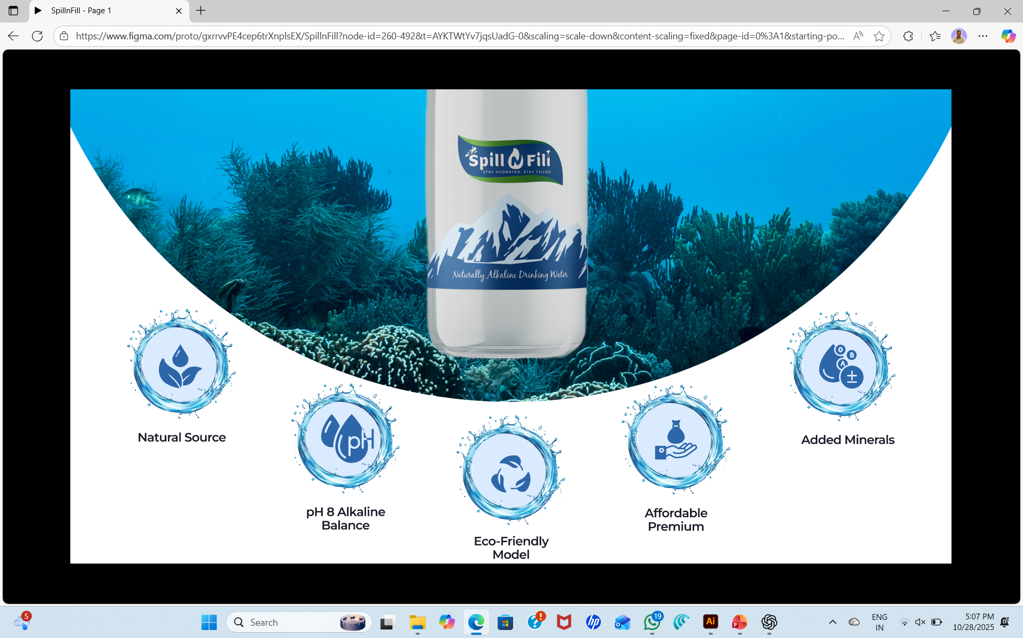

Slide 7
To delete “Balance”
To delete “Model”

Slide 8
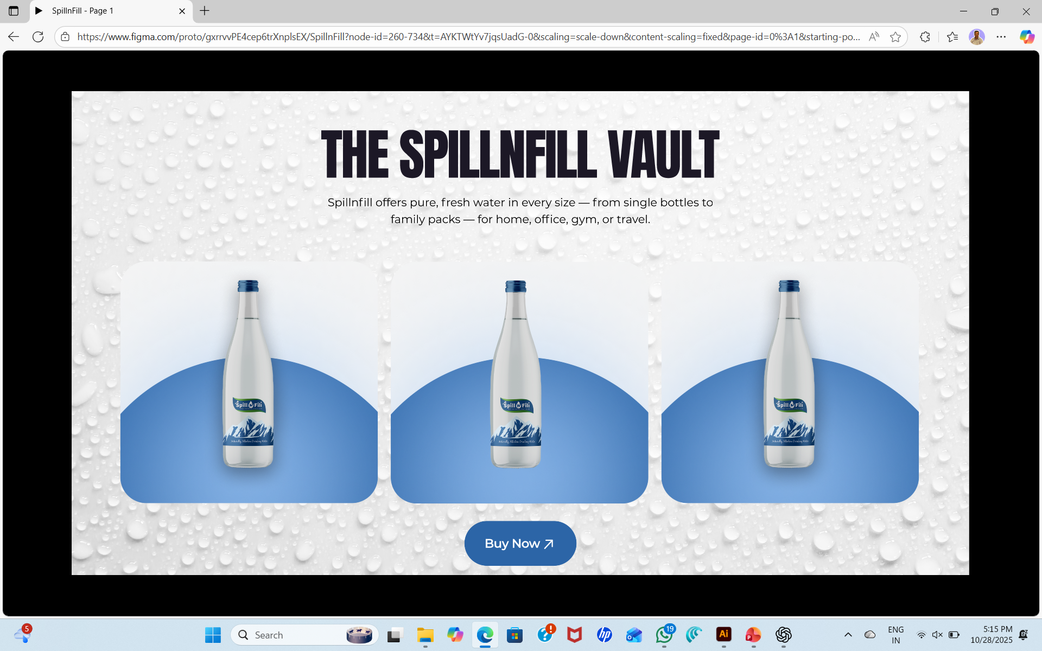

Slide 9
Correct “Spill N Fill” at 2 marked places.
Revised text:
Spill N Fill offers pure, great-tasting water in every convenient sizes. Perfect for home, office, gym, or travel — our packaging keeps water fresh while promoting reuse and reducing single-use waste.
The 4 product images with text would be in horizonal scrolling mode with side < & > arrows.
Remove the 2nd page on “The Spill N Fill Vault”

Slide 10
Revised text for each product photo
Glass Bottle – 750 ml (Photo)
PET Bottle – 1 ltr (Photo)
Natural Source
pH8 Alkaline
Eco-friendly
Affordable Premium
Glass Bottle
750 ml
Make in India
Natural Source
Added Minerals
Eco-friendly
Affordable
PET Bottle
1 ltr
Make in India

Slide 11
PET Bottle – 500 ml (Photo)
PET Bottle – 250 ml (Photo)
Natural Source
Added Minerals
Eco-friendly
Affordable
PET Bottle
500 ml
Make in India
Natural Source
Added Minerals
Eco-friendly
Affordable
PET Bottle
250 ml
Make in India

Slide 12
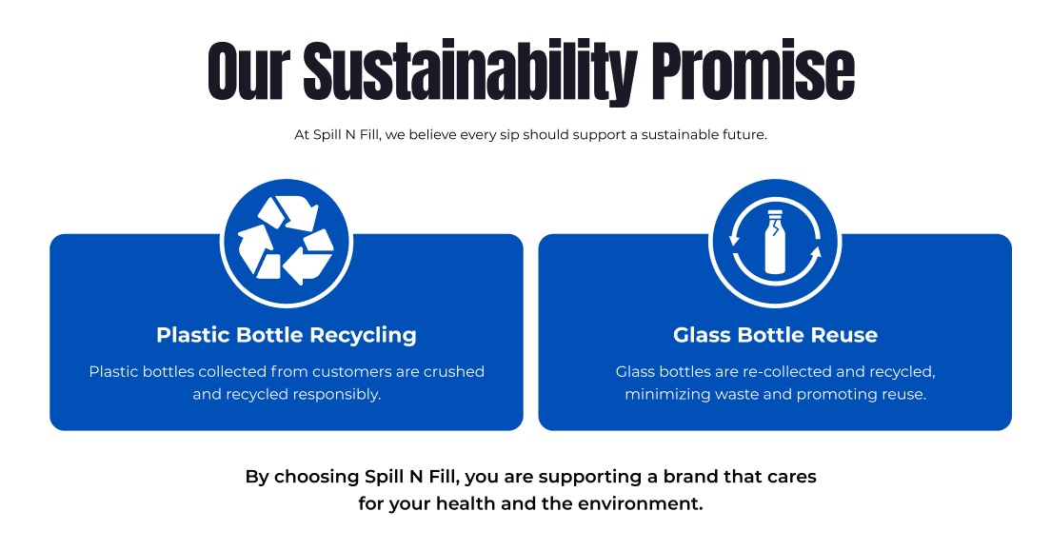
Replace ‘Testimonial Page’ with ‘Sustainability’

Slide 13
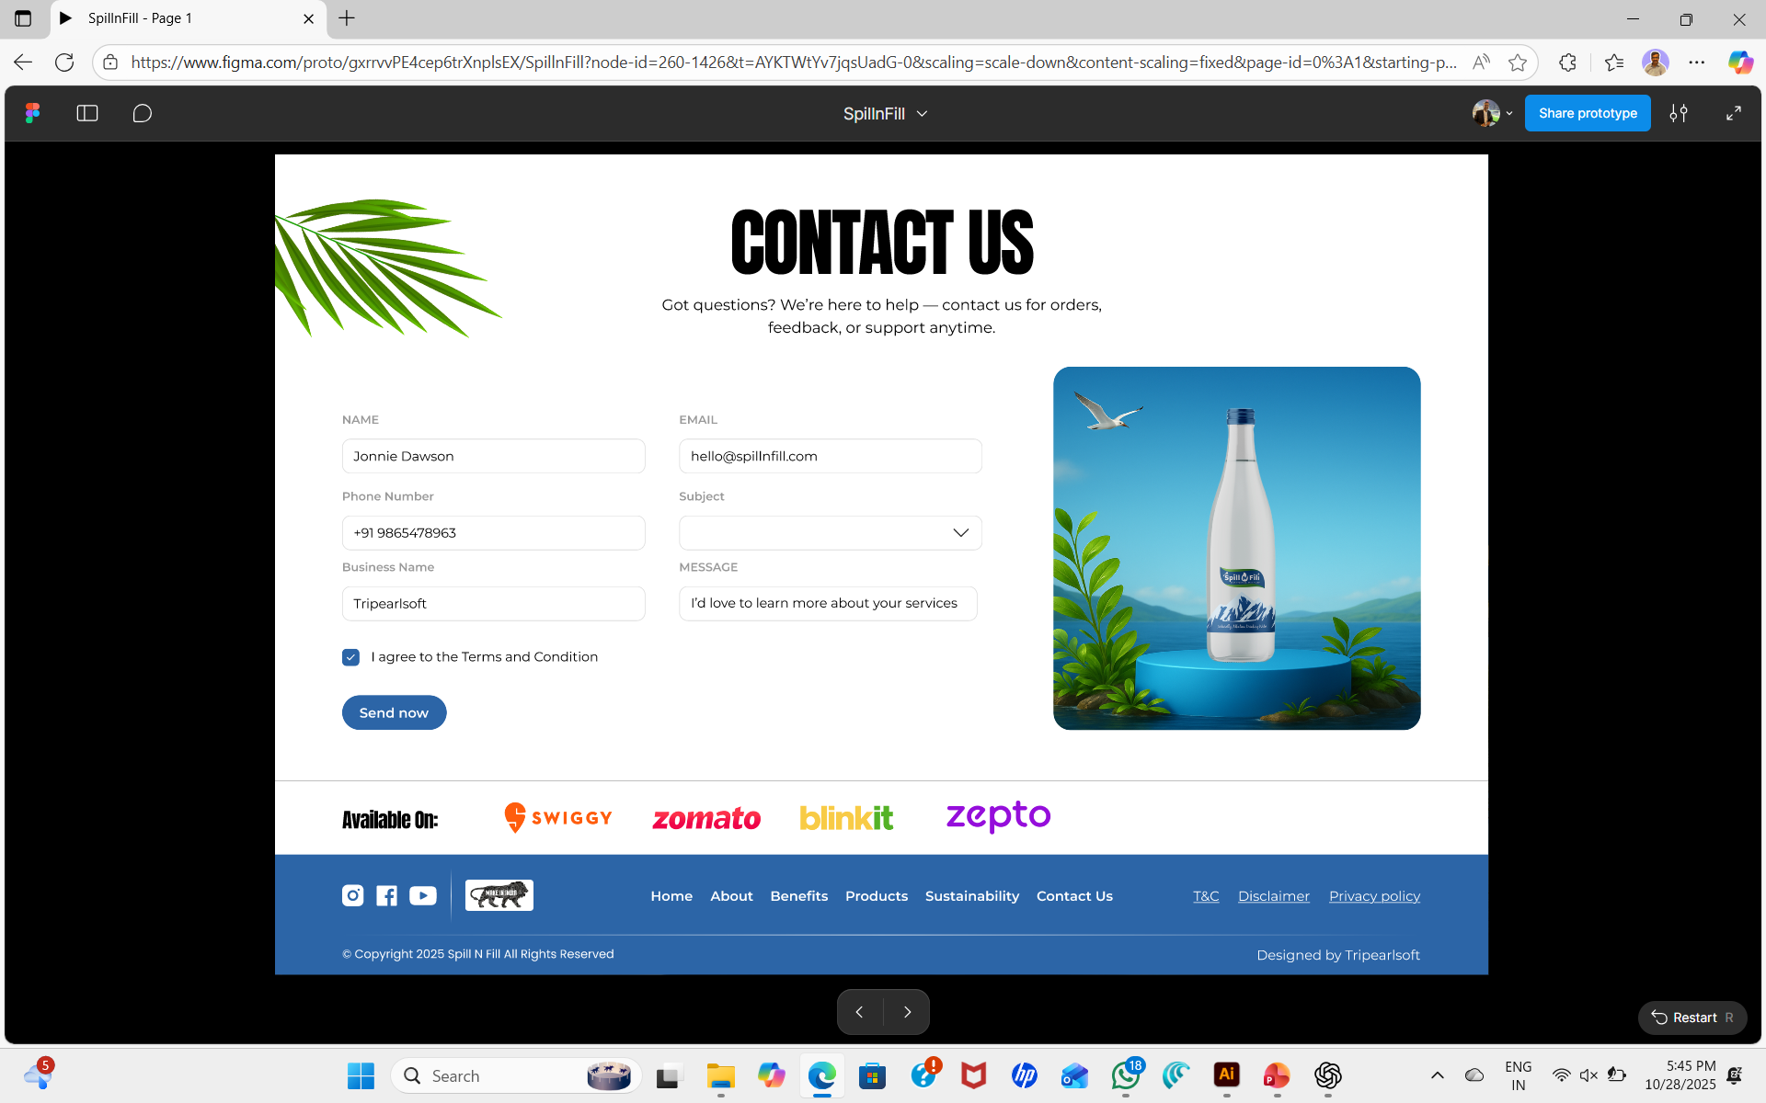

Slide 14
Remove ‘Social Media’ icons.
Remove ‘Available on’ with icons.
Increase the size of ‘Make in India’ and add ‘Swachh Bharat’ logo
To add the following addresses on this page:
Corporate Office
Regional Office
Subject (Drop down options)
Product Information
Business / Dealership Enquiry
Feedback or Suggestion

Slide 15
Contact Us
Corporate Office
Regional Office
Fourtrek Global Pvt. Ltd.
1st Floor, 103 Vraj Valencia,
B/h Mahindra Showroom,
Near Sola Bridge, Science City,
Ahmedabad – 380060
Phone: +91 90019 99089
E-mail: info@spillnfill.com
Fourtrek HoReCa Pvt. Ltd.
04, Dev Bag, Shobhagpura,
Nr. R K Circle, 80 Feet Ring Road,
Udaipur - 313001
Phone: +91 90019 99089
E-mail: info@fourtrekhoreca.com

